Slide 1
Moneyball in NBA
Predicting 2019 NBA Player Salary
5/15/2020
Takeshi Sugiyama

Slide 2
Dataset
20 Years of NBA player stats and salary (2000-2019).
Scraped from 2 websites.
https://www.basketball-reference.com (For stats)
https://hoopshype.com/salaries (For salary)
9310 rows and 33 columns after cleaning.
Train Set: 2000-2018 Seasons (8780 rows, 33 columns)
Test Set: 2019 Season (530 rows, 33 columns)

Slide 3
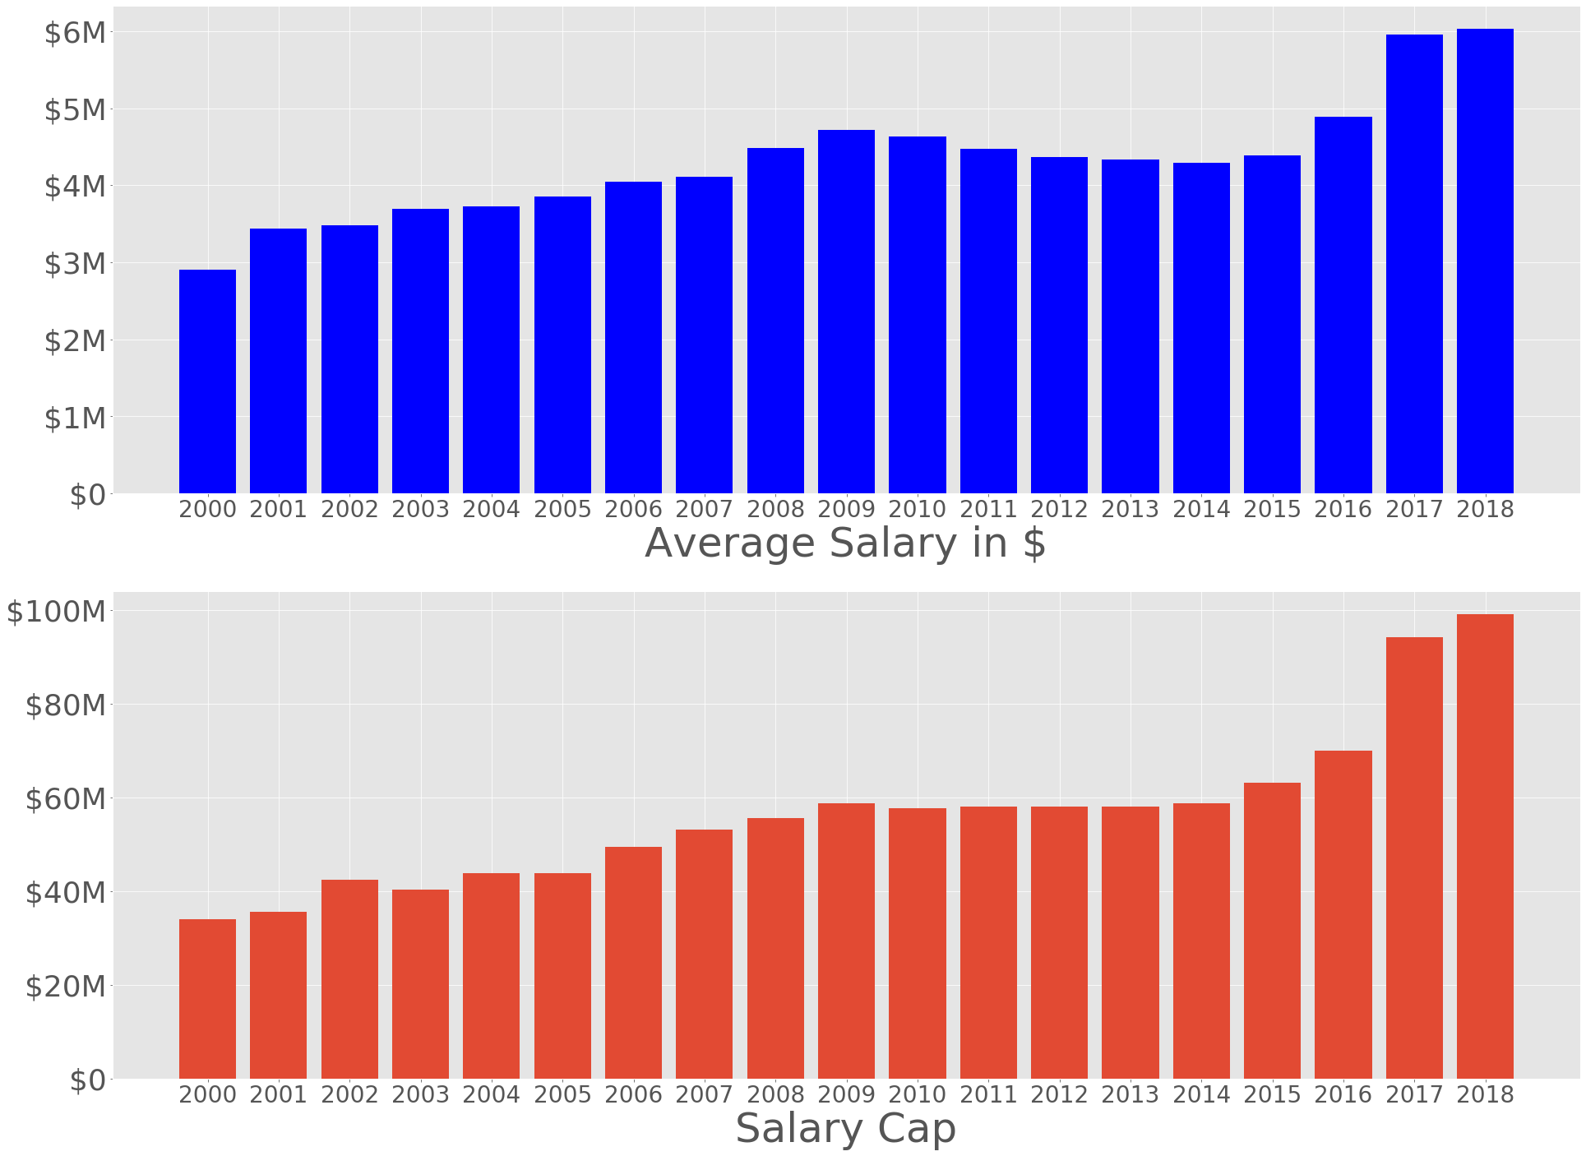
Average Salary & Salary Cap
*Salary Cap = Total $ amount each team can spend on their entire roster.

Slide 4
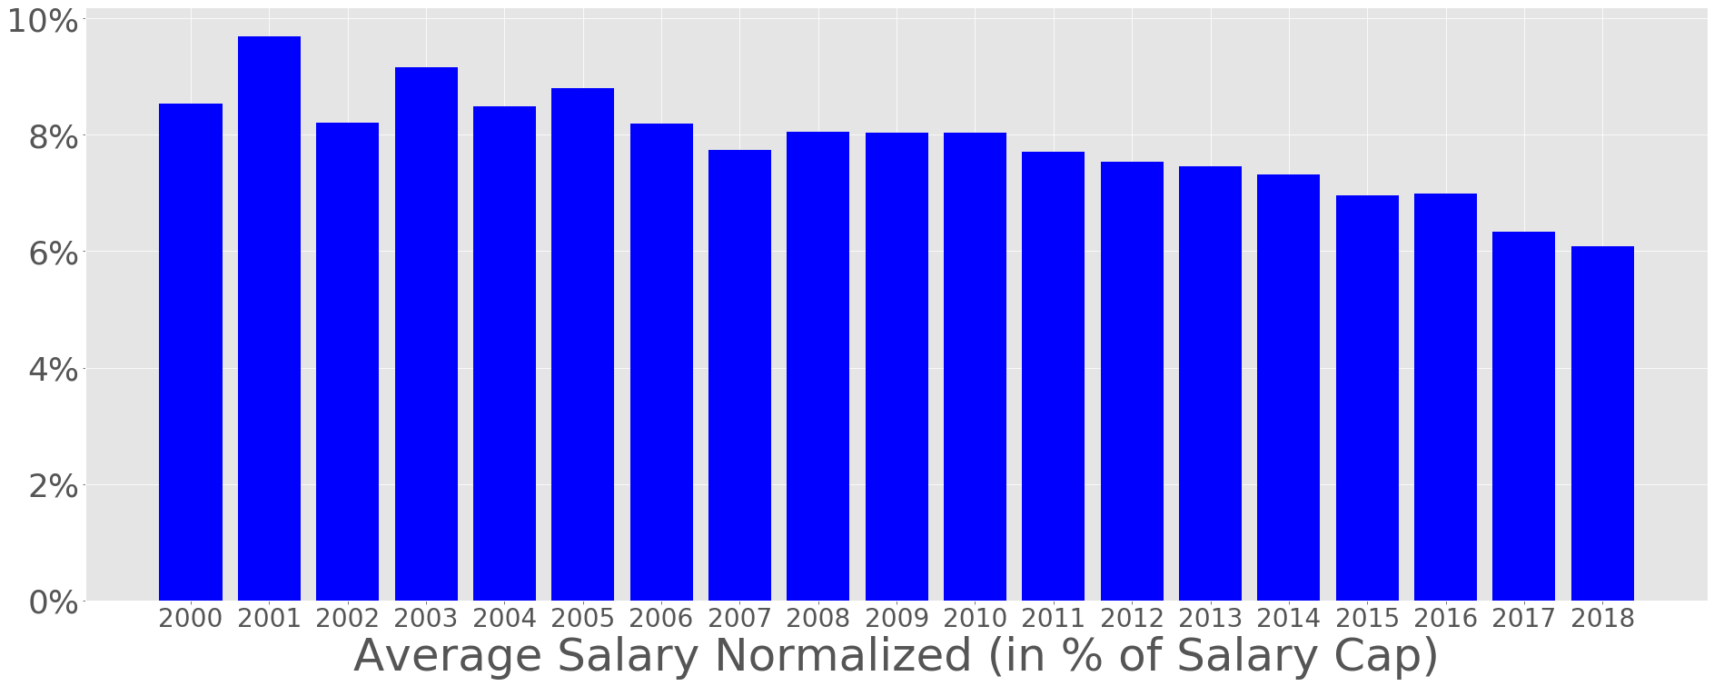
Average Salary (Normalized)

Slide 5
Steps to minimize root mean squared error (RMSE)
Baseline Model: Average salary RMSE: 0.07845
Model Selection: Gradient Boosting (out of 5 models) RMSE: 0.04681
Feature Selection: 6 features (out of 29 features) RMSE: 0.04653
Dataset Selection: 10 years (2009-2018) RMSE: 0.04614
Hyperparameter Tuning: Gridsearch RMSE: 0.04603

Slide 6
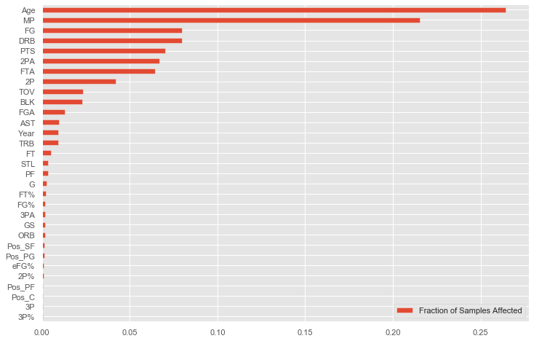
Feature importance
6 Features used:
Age
Games played
Total rebounds per game
Minutes played per game
Free throw attempts per game
Year

Slide 7
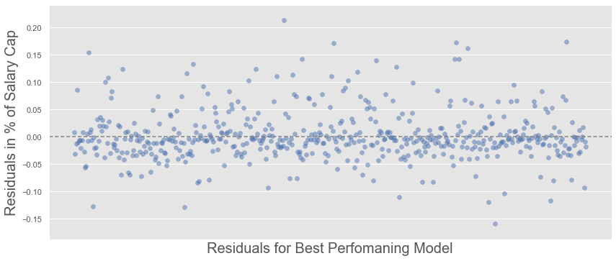
Findings
Outcome
Final RMSE: 0.04603
Improved RMSE from baseline of $8M to $4.7M.
Room for improvement
High error rate (Average salary for test set is 0.06398).
Test data distribution
Count: 530
Mean: 0.06398
Std: 0.07724
Min: 0.00046
25%: 0.01353
50%: 0.02706
75%: 0.09346
Max: 0.3677

Slide 8
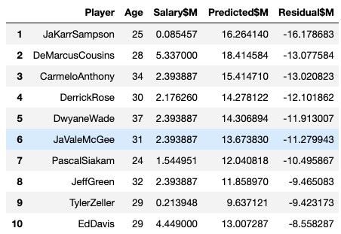
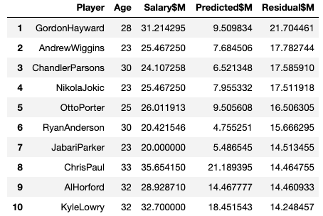
Future work
Feature engineering
Use absolute numbers for statistics
Consider salary cap increase in 2017
Nice to have
Rookie contract
Injury
Most underrated
Most overrated

Slide 9
Thank you! https://github.com/taksug229/nba-salary-prediction

